Slide 1
RAG & Agentic Workflows’ Success Stories
李浩瑞
2025.02.28
北京

Slide 2
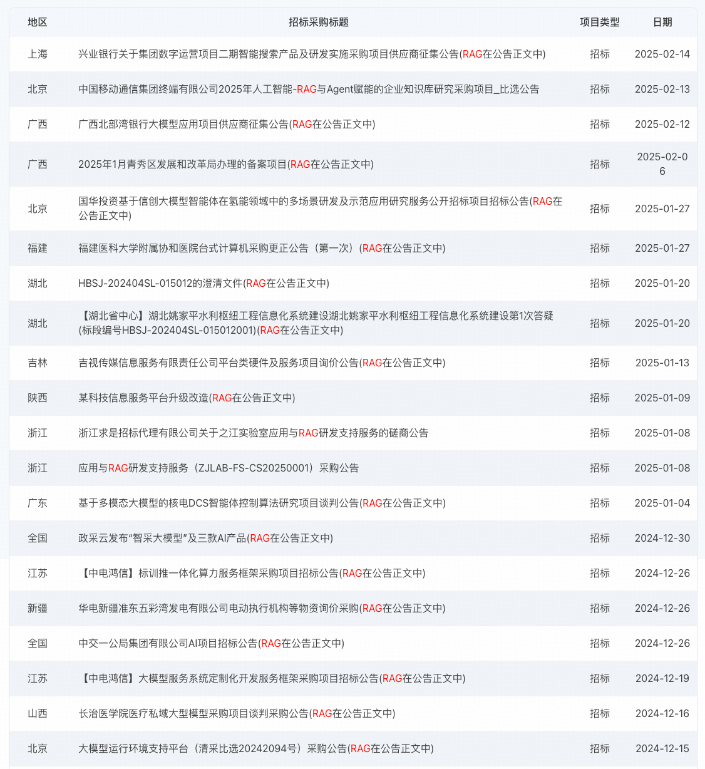
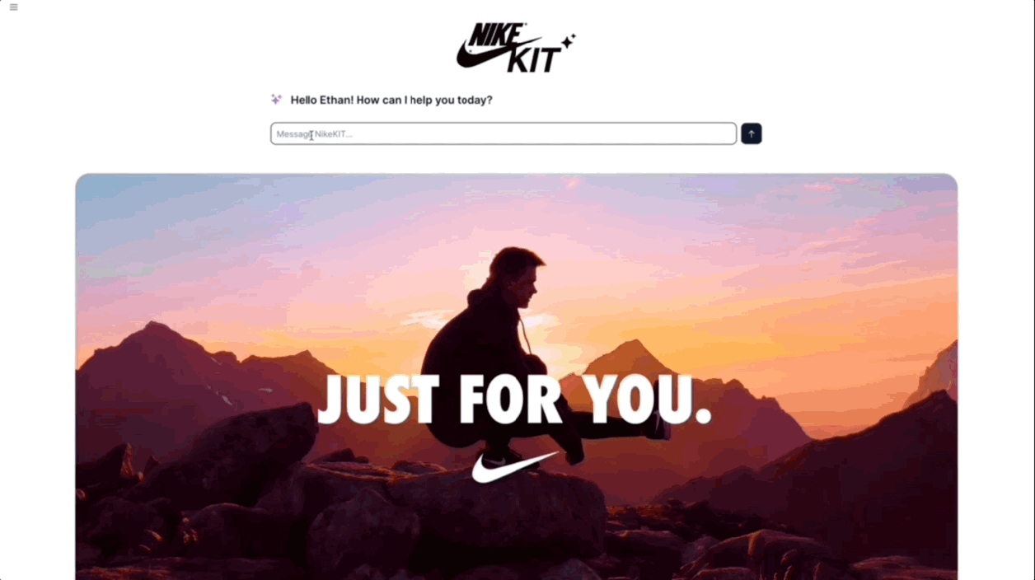
RAG: Why, When, How
大量真实客户需求
市场需要的就是好的
本质上是搜索引擎+生成式AI
技术相对稳定，能上生产环境

Slide 3
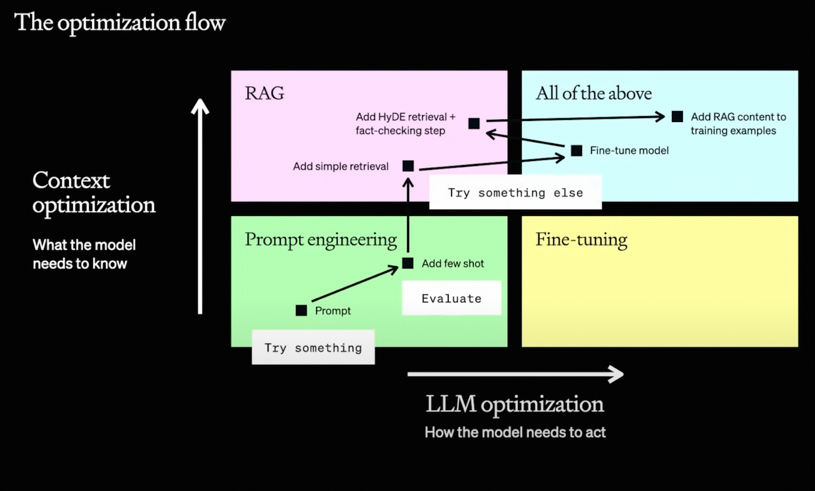
RAG: Why, When, How
什么时候Prompt/FT/RAG
Prompt: 补充上下文（角色扮演，任务拆解，规范输出，低成本提高能力）
FineTuning: 对齐（可读性，安全性），有泛化能力的新模型（金融大模型，医疗大模型）
RAG: 外界补充信息（外部API, 私有知识库代码库，用户自定义消息）
You are here!

Slide 4
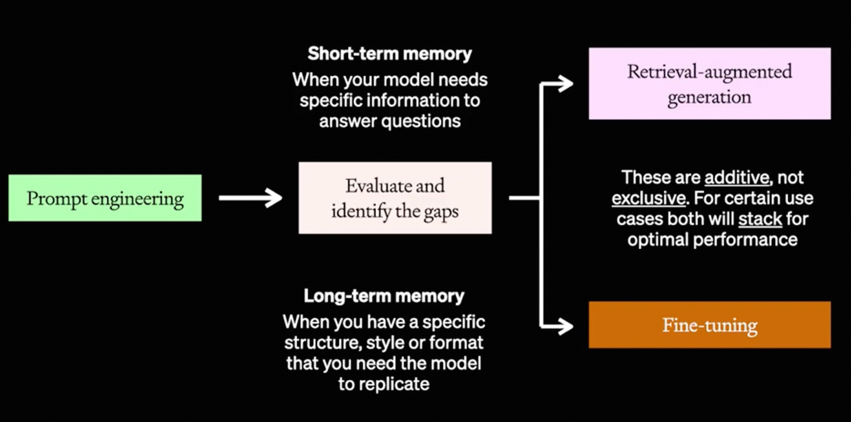
RAG: Why, When, How
什么时候只能RAG
上下文需补充大量内容/动态内容
Prompt工程只能提供有限的例子
few-shot
FineTuning只能提供历史的数据
实时天气，用户自定义数据
无法容忍幻觉
严肃场景
政府咨询，医疗建议
需明确信源
商务询盘，学术写作
什么时候不能RAG
长期泛化能力（RAG就像开卷考试）
Token敏感 (召回的内容消耗大量输入)
超大范围知识（百万份文档）
基模能力不足（新语言/领域，格式）

Slide 5
RAG: Why, When, How
[SYSTEM]
RAG Pipeline Activated
- Query Analysis: Detected informational query about renewable energy storage
- Vector Search: Scanning 5 internal technical databases
- Relevance Filtering: Selected top 2 documents with similarity scores >0.82
[USER QUERY]
"What are the most promising innovations in battery technology for grid-scale solar energy storage?"

Slide 6
RAG: Why, When, How
[SYSTEM]
RAG Pipeline Activated
- Query Analysis: Detected informational query about renewable energy storage
- Vector Search: Scanning 5 internal technical databases
- Relevance Filtering: Selected top 2 documents with similarity scores >0.82
[USER QUERY]
"What are the most promising innovations in battery technology for grid-scale solar energy storage?"
[RETRIEVAL CONTEXT]
1. Document ID: ESD-2023-045 (Last updated: 2023-11-15)
Content: "Liquid metal battery systems using calcium-antimony electrodes demonstrate 75% round-trip efficiency at $20/kWh capital cost, with 15-year lifespan under daily cycling"
2. Document ID: MIT-TR-7781 (Access date: 2024-02-03)
Content: "Solid-state lithium-air batteries achieve theoretical energy density of 11,140 Wh/kg, though cycle stability remains challenge (current prototype: 50 cycles @ 80% capacity retention)"
[ASSISTANT RESPONSE]
Current grid-scale battery innovations show three promising directions:
1. Liquid Metal Systems (Calcium-Antimony):
- 75% efficiency
- $20/kWh cost
- 15-year lifespan
- Best for daily cycling applications
2. Solid-State Lithium-Air Prototypes:
- Ultra-high 11,140 Wh/kg density
- Current limitation: 50-cycle stability
- Potential for aviation/transport use
All data current through Q4 2023, with liquid metal systems being most deployment-ready based on recent DOE demonstrations.
文档召回发生在LLM输入之前
给LLM的Input包含了从文档里召回的内容
LLM Output根据用户的问题和补充上下文进行输出

Slide 7
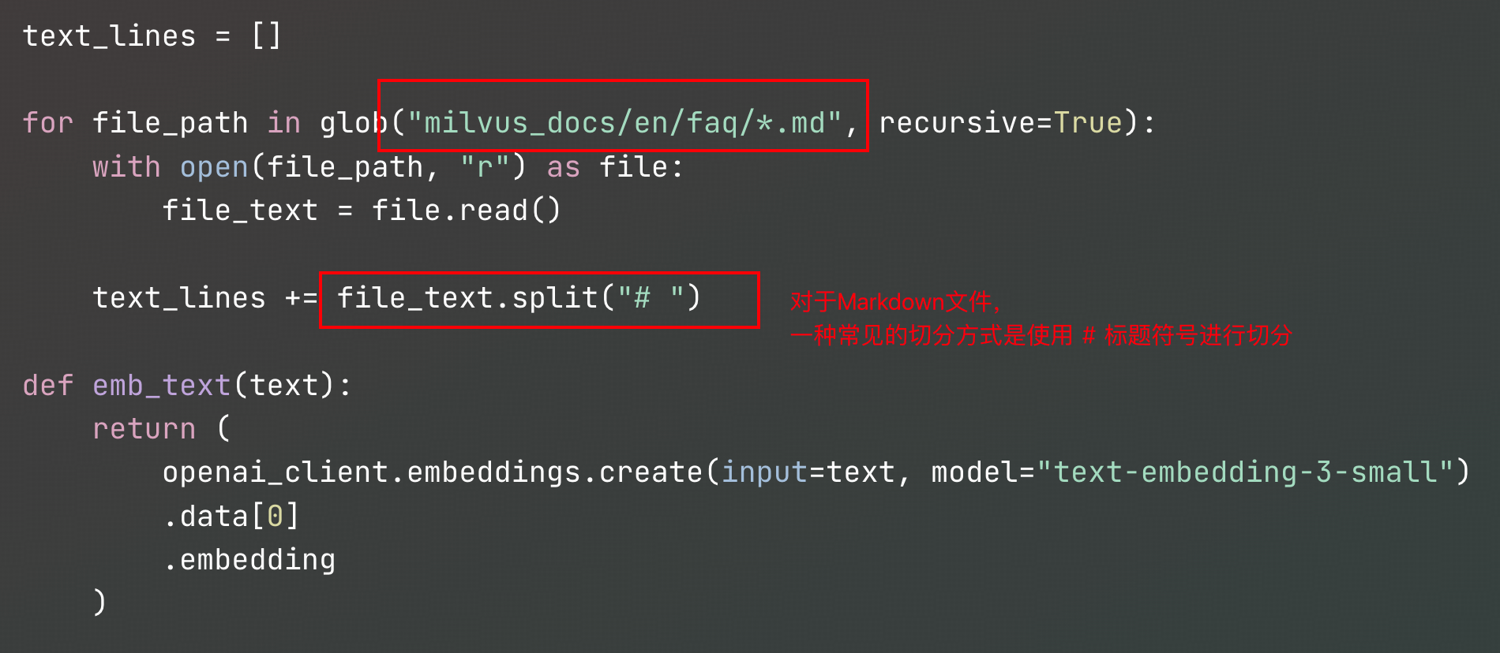
RAG: Why, When, How
一步步构建Knowledge Source
第一步：分块（Chunk）
这一步的目的是减少Embedding模型输入的信息噪音，最佳状态是一个最小知识点为一个分块，同时丢弃对系统无关的知识

Slide 8
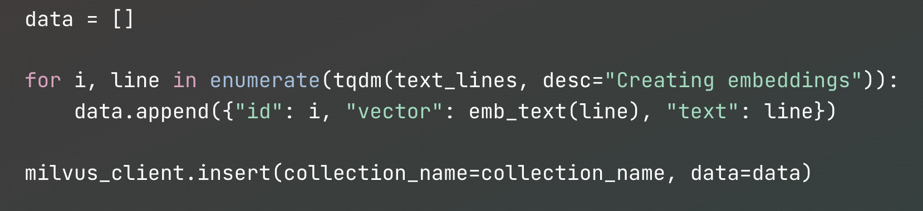
RAG: Why, When, How
一步步构建Knowledge Source
第二步：词嵌入，存入结果到向量数据库（Milvus db对AI应用的支持是所有开源向量数据库里最好的）
这一步的目的是持久化数据，只需要嵌入一次

Slide 9
RAG: Why, When, How
一步步构建Knowledge Source
第二步：词嵌入，存入结果到向量数据库（Milvus db对AI应用的支持是所有开源向量数据库里最好的）
这一步的目的是持久化数据，只需要嵌入一次
注意到：如果切换了词嵌入模型，向量空间改变，所有数据库的内容变得无意义！

Slide 10
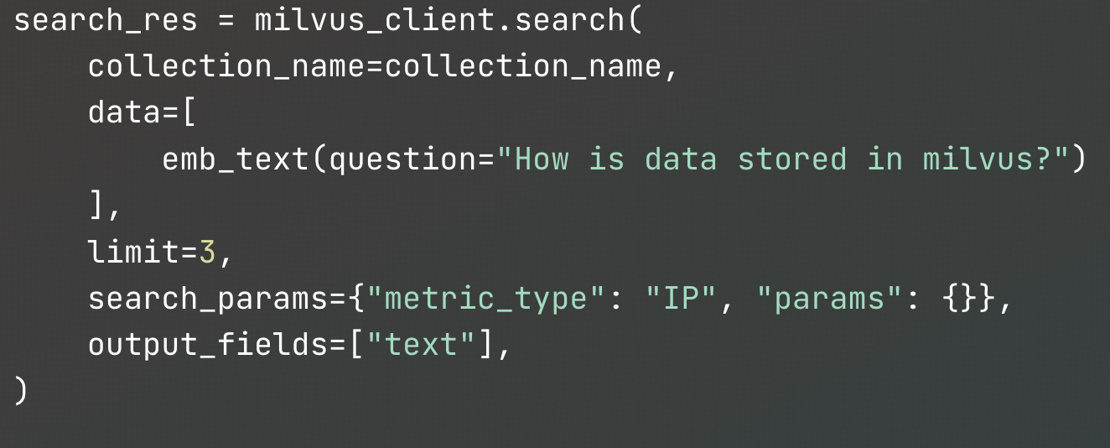
RAG: Why, When, How
[
[
" Where does Milvus store data?\n\nMilvus deals with two types of data, inserted data and metadata. \n\nInserted data, including vector data, scalar data, and collection-specific schema, are stored in persistent storage as incremental log. Milvus supports multiple object storage backends, including [Azure Blob Storage](https://azure.microsoft.com/en-us/products/storage/blobs), [Alibaba Cloud OSS](https://www.alibabacloud.com/product/object-storage-service), and [Tencent Cloud Object Storage](https://www.tencentcloud.com/products/cos) (COS).\n\nMetadata are generated within Milvus. Each Milvus module has its own metadata that are stored in etcd.\n\n###",
0.7883545756340027
],
[
"How does Milvus handle vector data types and precision?\n\nMilvus supports Binary, Float32, Float16, and BFloat16 vector types.\\n\n###",
0.6757288575172424
],
[
"How much does Milvus cost?\n\nMilvus is a 100% free open-source project.\n\nPlease adhere to [Apache License 2.0](http://www.apache.org/licenses/LICENSE-2.0) when using Milvus for production or distribution purposes.\n\nZilliz, the company behind Milvus, also offers a fully managed cloud version of the platform for those that don't want to build and maintain their own distributed instance. [Zilliz Cloud](https://zilliz.com/cloud) automatically maintains data reliability and allows users to pay only for what they use.\n\n###",
0.6421123147010803
]
]
一步步构建Knowledge Source
第三步：把用户查询嵌入为向量，根据向量距离召回
使用相同的嵌入模型，把用户提问嵌入为向量
搜索数据库里与问句最近的向量

Slide 11
RAG: Why, When, How
[
[
" Where does Milvus store data?\n\nMilvus deals with two types of data, inserted data and metadata. \n\nInserted data, including vector data, scalar data, and collection-specific schema, are stored in persistent storage as incremental log. Milvus supports multiple object storage backends, including [Azure Blob Storage](https://azure.microsoft.com/en-us/products/storage/blobs), [Alibaba Cloud OSS](https://www.alibabacloud.com/product/object-storage-service), and [Tencent Cloud Object Storage](https://www.tencentcloud.com/products/cos) (COS).\n\nMetadata are generated within Milvus. Each Milvus module has its own metadata that are stored in etcd.\n\n###",
0.7883545756340027
],
[
"How does Milvus handle vector data types and precision?\n\nMilvus supports Binary, Float32, Float16, and BFloat16 vector types.\\n\n###",
0.6757288575172424
],
[
"How much does Milvus cost?\n\nMilvus is a 100% free open-source project.\n\nPlease adhere to [Apache License 2.0](http://www.apache.org/licenses/LICENSE-2.0) when using Milvus for production or distribution purposes.\n\nZilliz, the company behind Milvus, also offers a fully managed cloud version of the platform for those that don't want to build and maintain their own distributed instance. [Zilliz Cloud](https://zilliz.com/cloud) automatically maintains data reliability and allows users to pay only for what they use.\n\n###",
0.6421123147010803
]
]
一步步构建Knowledge Source
第三步：把用户查询嵌入为向量，根据向量距离召回
使用相同的嵌入模型，把用户提问嵌入为向量
搜索数据库里与问句最近的向量
注：主流向量数据库使用近似近邻（ANN）算法进行搜索
相比KNN有极好加速
但由于近似性的存在，因此K通常要取大一些

Slide 12
RAG: Why, When, How
[SYSTEM]
RAG Pipeline Activated
- Query Analysis: Detected informational query about renewable energy storage
- Vector Search: Scanning 5 internal technical databases
- Relevance Filtering: Selected top 2 documents with similarity scores >0.82
[USER QUERY]
"What are the most promising innovations in battery technology for grid-scale solar energy storage?"
[RETRIEVAL CONTEXT]
1. Document ID: ESD-2023-045 (Last updated: 2023-11-15)
Content: "Liquid metal battery systems using calcium-antimony electrodes demonstrate 75% round-trip efficiency at $20/kWh capital cost, with 15-year lifespan under daily cycling"
2. Document ID: MIT-TR-7781 (Access date: 2024-02-03)
Content: "Solid-state lithium-air batteries achieve theoretical energy density of 11,140 Wh/kg, though cycle stability remains challenge (current prototype: 50 cycles @ 80% capacity retention)"
一步步构建Knowledge Source
第四步：召回的内容塞入LLM上下文

Slide 13
RAG: Why, When, How
[SYSTEM]
RAG Pipeline Activated
- Query Analysis: Detected informational query about renewable energy storage
- Vector Search: Scanning 5 internal technical databases
- Relevance Filtering: Selected top 2 documents with similarity scores >0.82
[USER QUERY]
"What are the most promising innovations in battery technology for grid-scale solar energy storage?"
[RETRIEVAL CONTEXT]
1. Document ID: ESD-2023-045 (Last updated: 2023-11-15)
Content: "Liquid metal battery systems using calcium-antimony electrodes demonstrate 75% round-trip efficiency at $20/kWh capital cost, with 15-year lifespan under daily cycling"
2. Document ID: MIT-TR-7781 (Access date: 2024-02-03)
Content: "Solid-state lithium-air batteries achieve theoretical energy density of 11,140 Wh/kg, though cycle stability remains challenge (current prototype: 50 cycles @ 80% capacity retention)"
一步步构建Knowledge Source
第四步：召回的内容塞入LLM上下文
注意到：
如果召回了无关的内容，会消耗额外的token
如果召回的内容太多，会超过LLM的最大上下文
如果召回了被污染的内容，会导致LLM被误导甚至被攻击

Slide 14
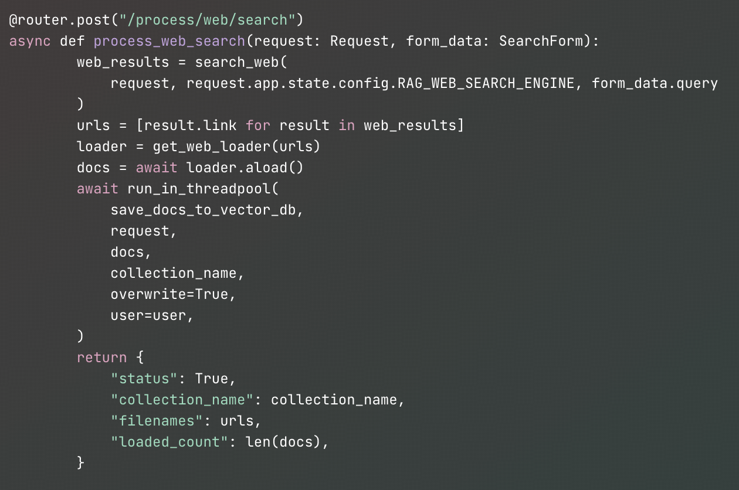
RAG: Why, When, How
一步步构建Knowledge Source
进阶：对话中联网搜索，以OpenWebUI源码为例
1.使用搜索引擎，通过用户的query拿到url
2.解析url里的文本内容，切Chunk
3.解析后的内容做嵌入，存入向量数据库
4.默认新搜索会覆盖同名搜索内容
5.collection_name类似数据的id
会在对话召回中作为filter

Slide 15
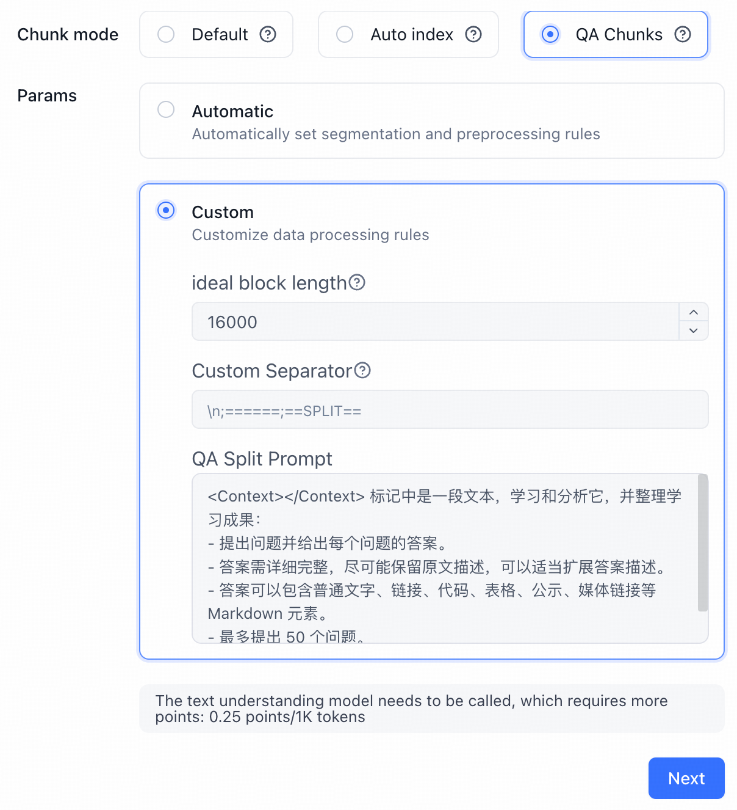
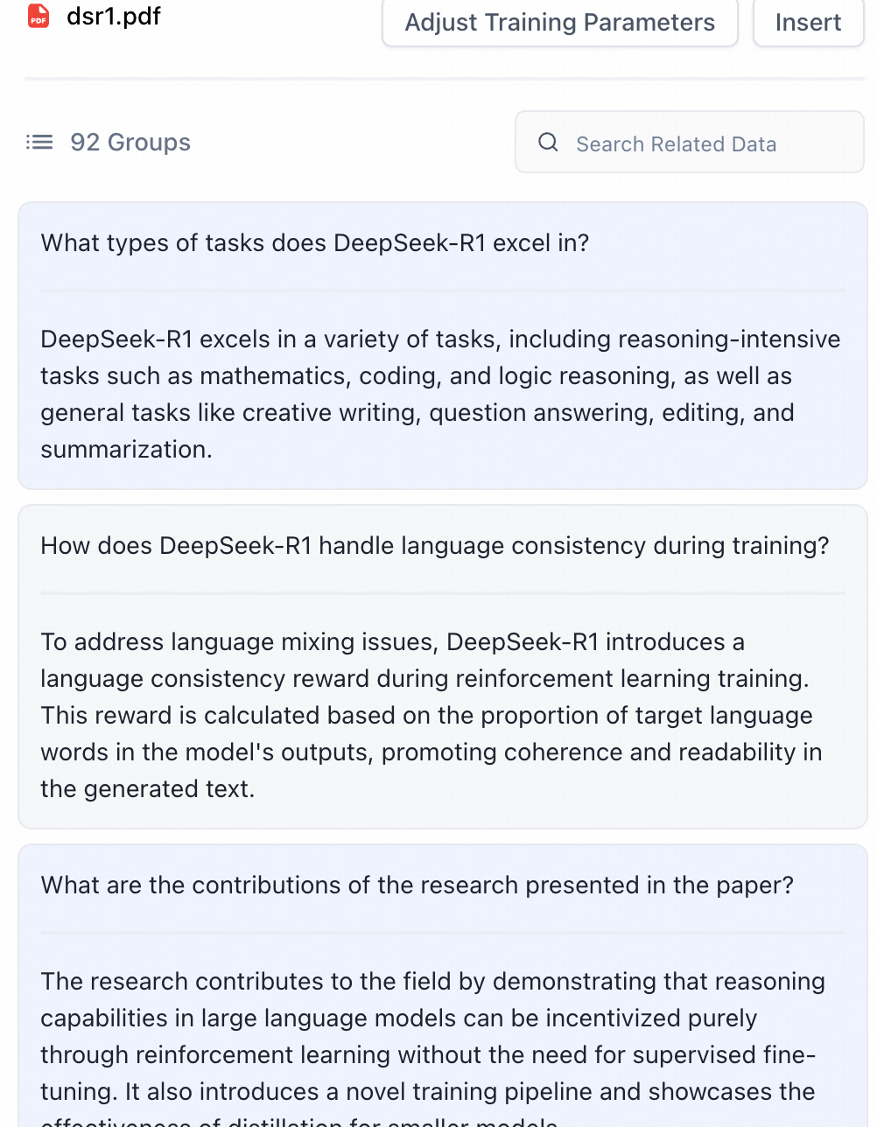
RAG: Why, When, How
<Context></Context> 标记中是一段文本，学习和分析它，并整理学习成果：
- 提出问题并给出每个问题的答案。
- 答案需详细完整，尽可能保留原文描述，可以适当扩展答案描述。
- 最多提出 50 个问题。
请按以下格式整理学习成果:
<Context>
文本
</Context>
Q1: 问题。
A1: 答案。
Q2:
A2:
------
我们开始吧!
<Context>
{{text}}
</Context>
召回能力提升的常见手段
文本阶段

Slide 16
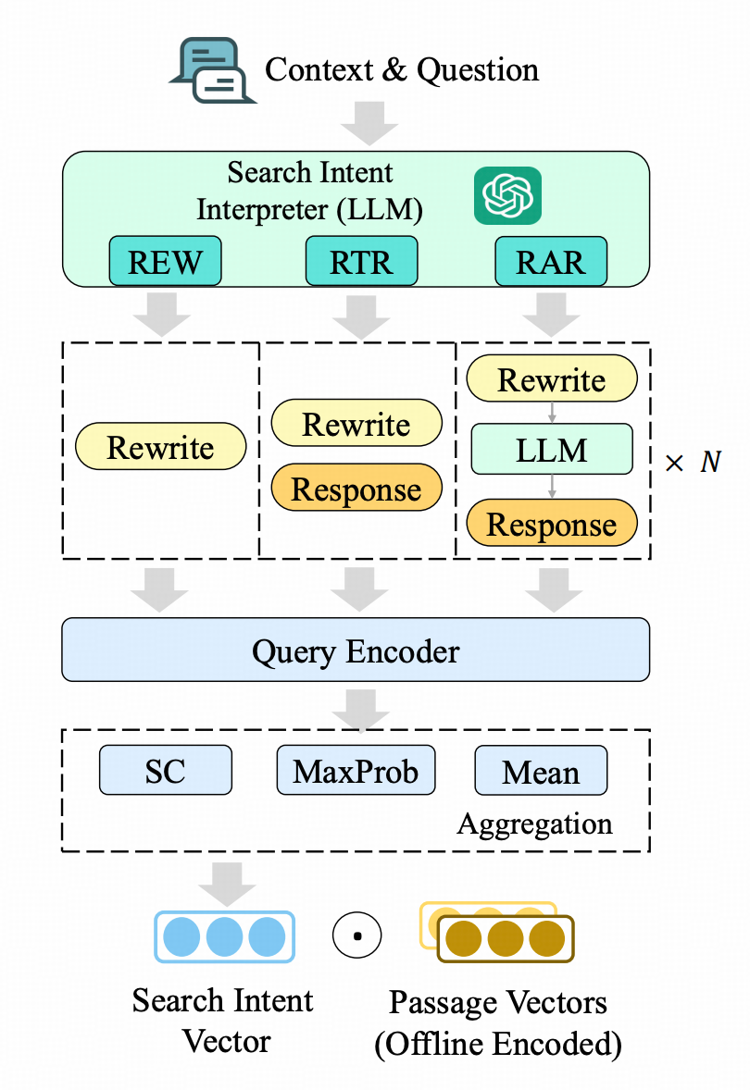
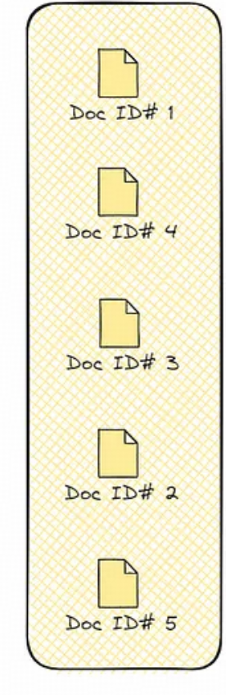
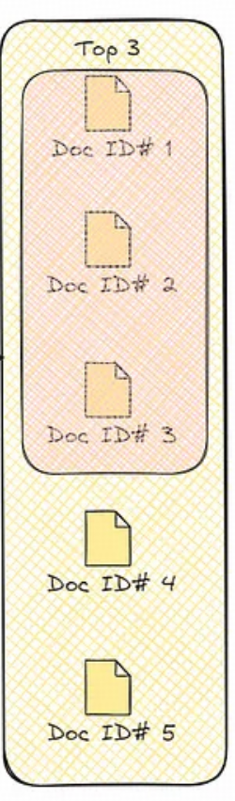
RAG: Why, When, How
召回能力提升的常见手段
文本阶段
召回阶段

Slide 17
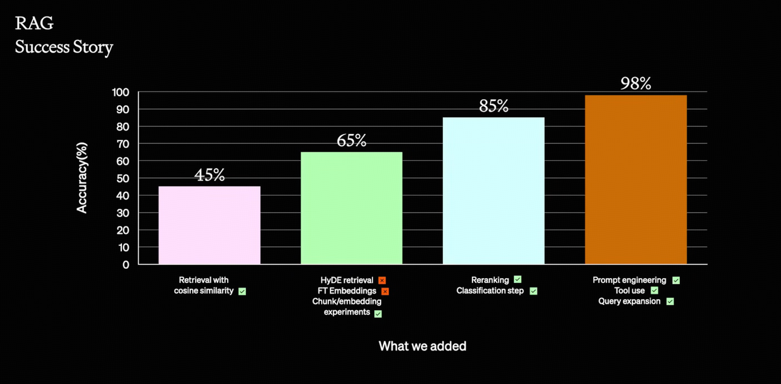
No Free Lunch!

Slide 18
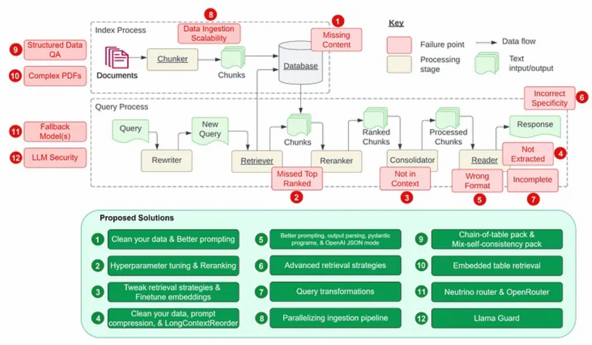
No Free Lunch!

Slide 19
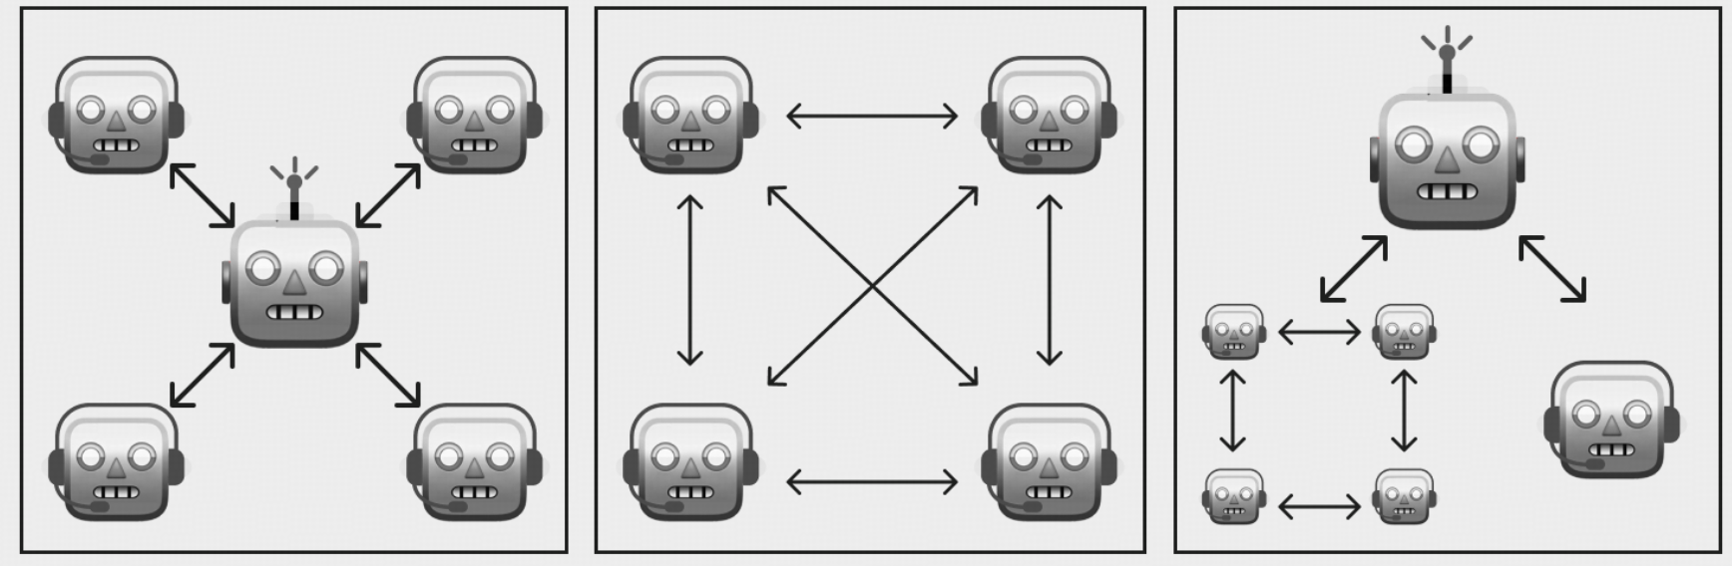
Agentic Workflows: Why, When, How
代表未来的协作形态
高抽象，高解耦，多模型，可扩展，自定义程度高

Slide 20
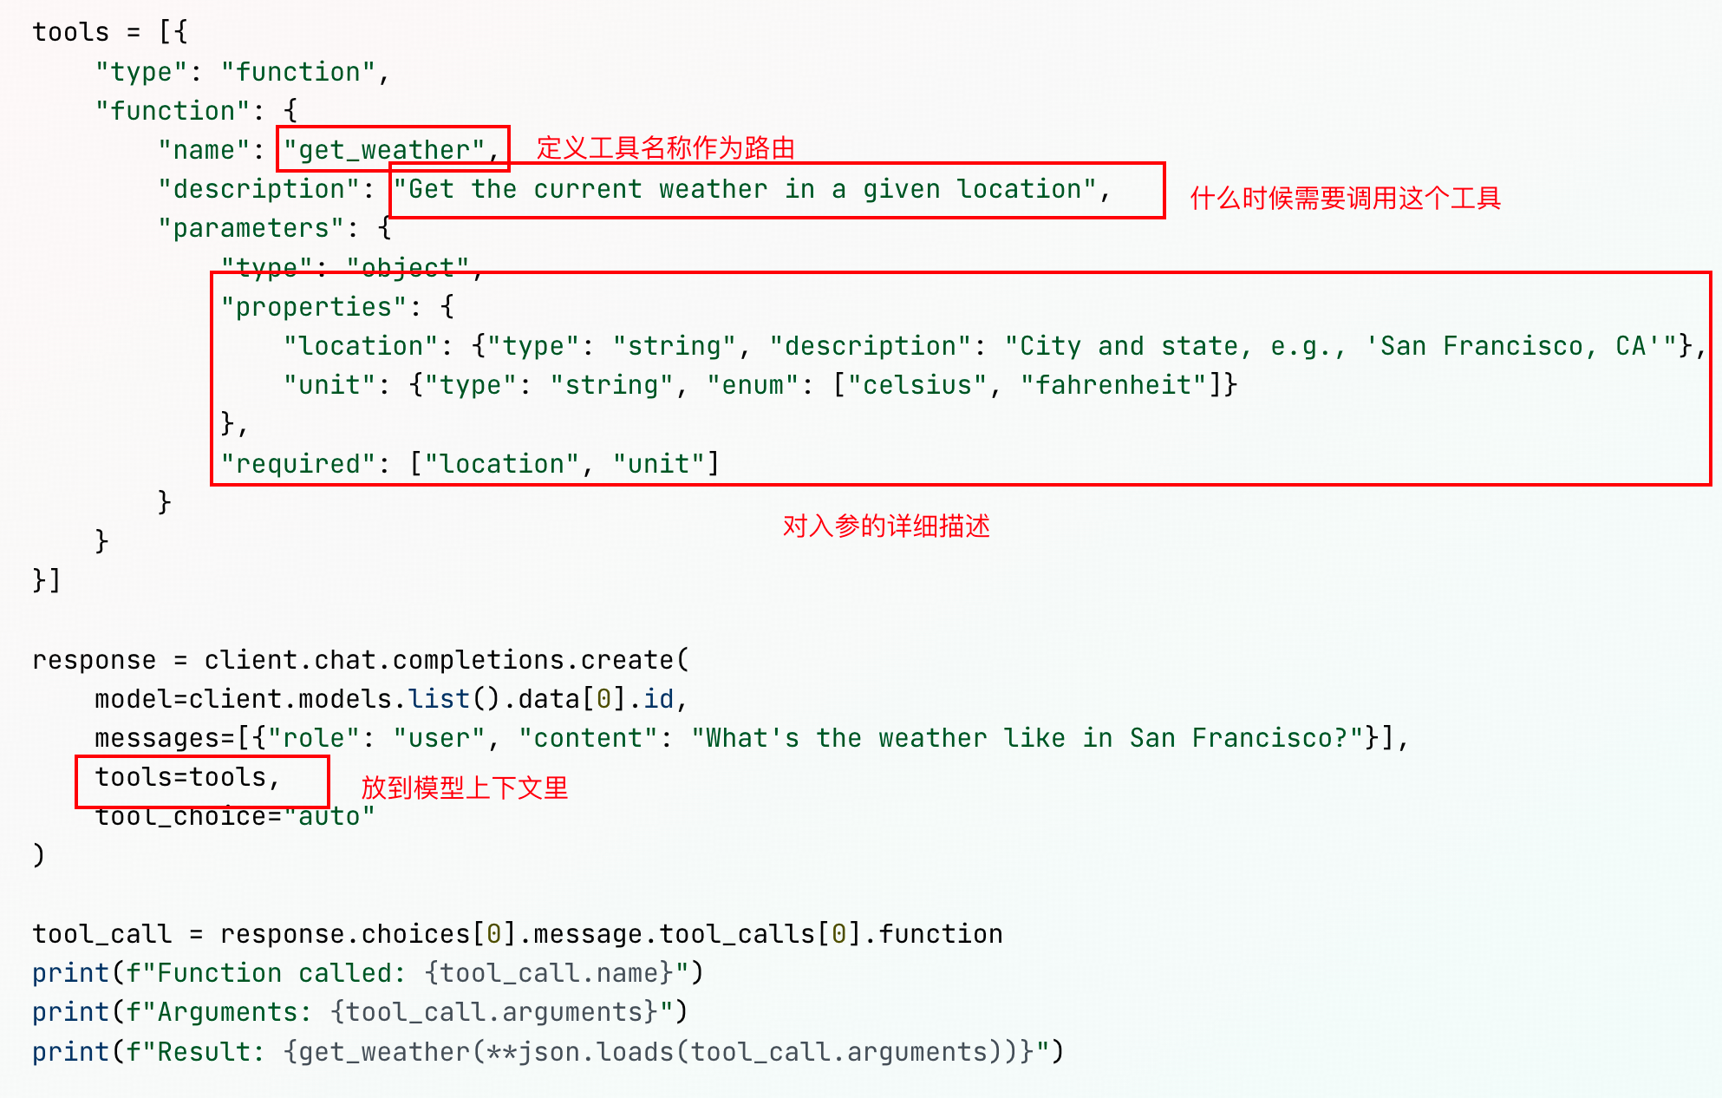
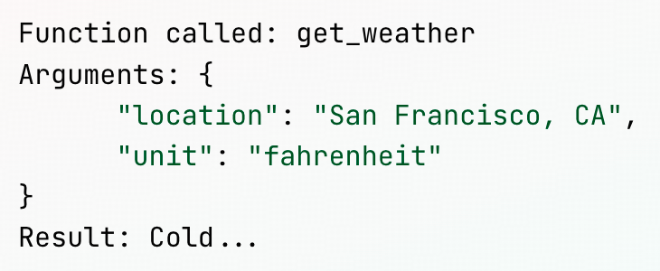
Agentic Workflows: Why, When, How
前置知识：
LLM是如何在运行中调用工具的

Slide 21
Agentic Workflows: Why, When, How
前置知识：
LLM是如何在运行中调用工具的
注意到：
1. RAG是一种把向量数据库做工具调用的特例
2. 只有对Tools格式微调过的模型才能正确生成 Json 调用工具（DeepSeek R1就没有做）

Slide 22
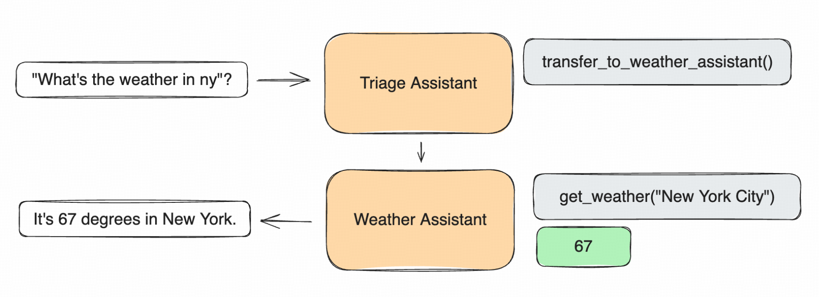
Agentic Workflows: Why, When, How
任何时候你都可以用Agentic Workflow重构你的AI App

Slide 23
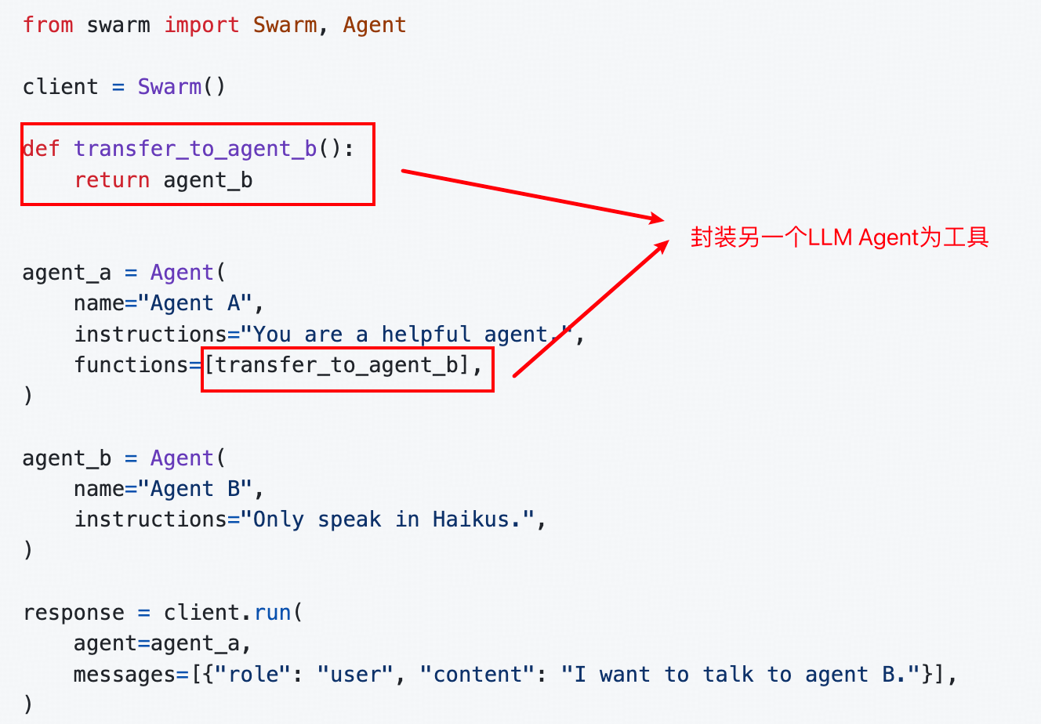
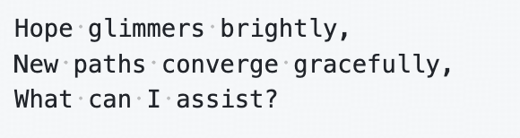

Agentic Workflows: Why, When, How
最简单的Agentic Workflow: Swarm
俳句俳句俳
俳句俳句俳句俳
俳句俳

Slide 24
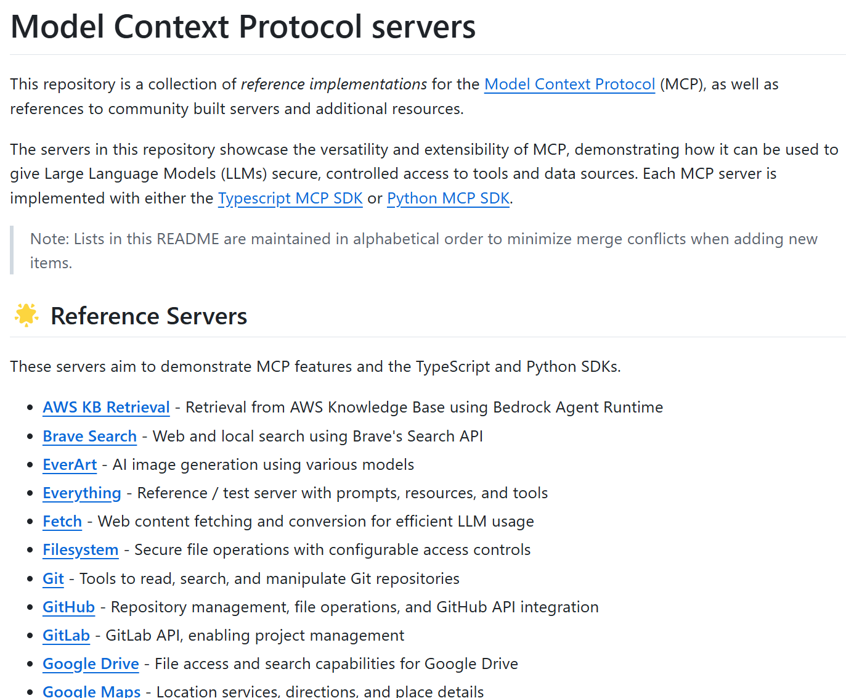
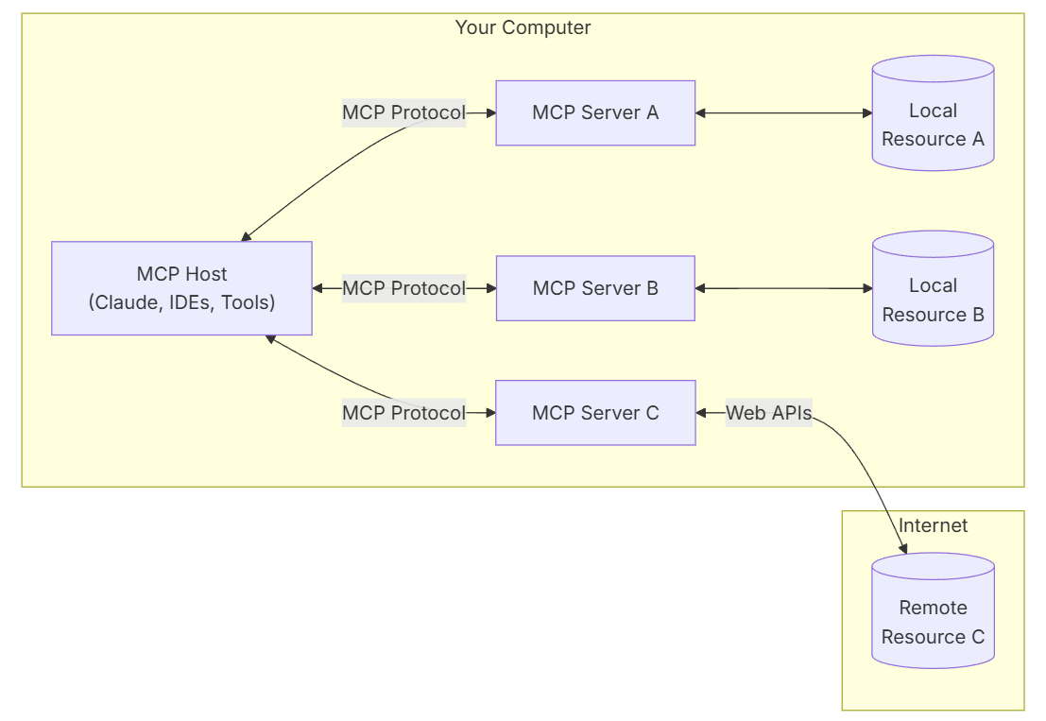
Agentic Workflows: Why, When, How

Slide 25
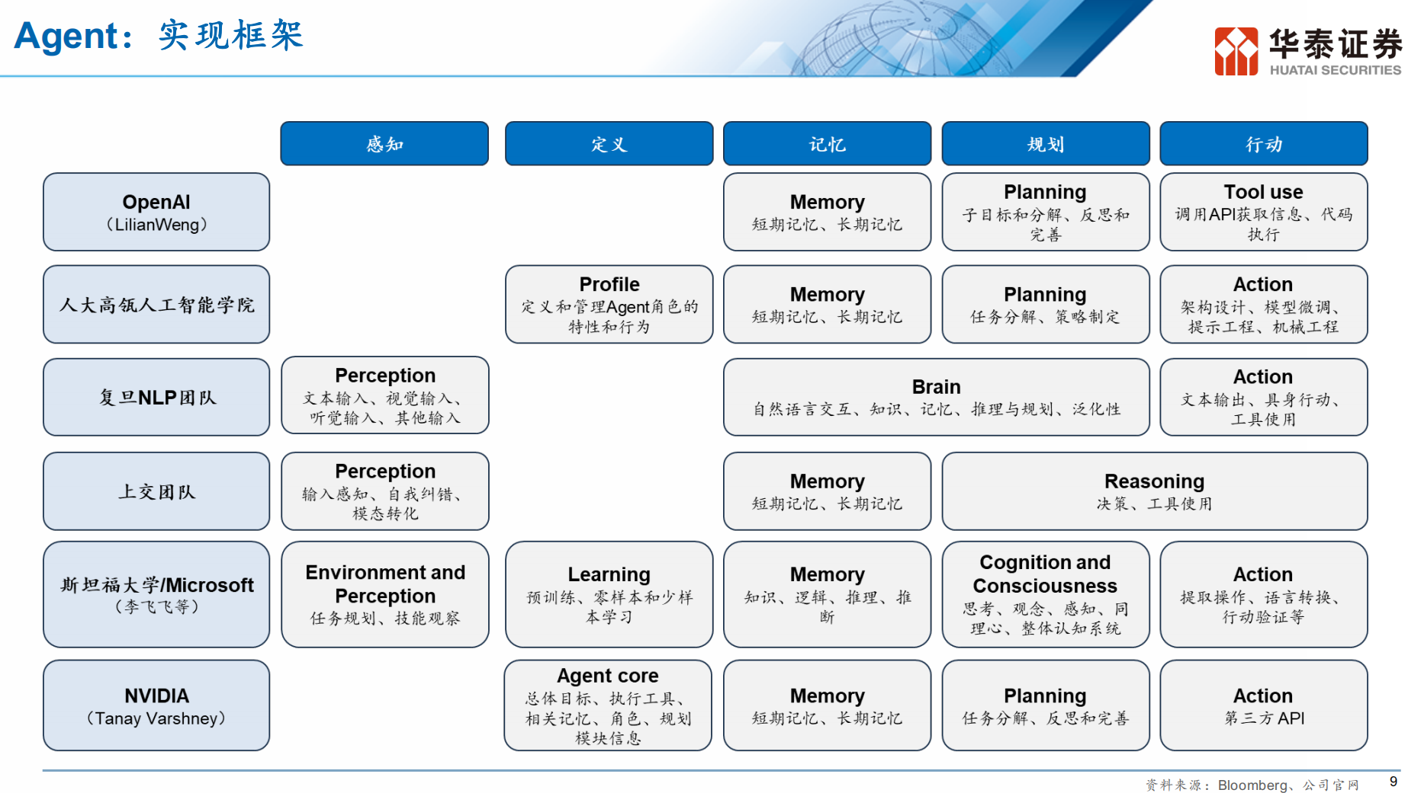
Agentic Workflows: Why, When, How

Slide 26
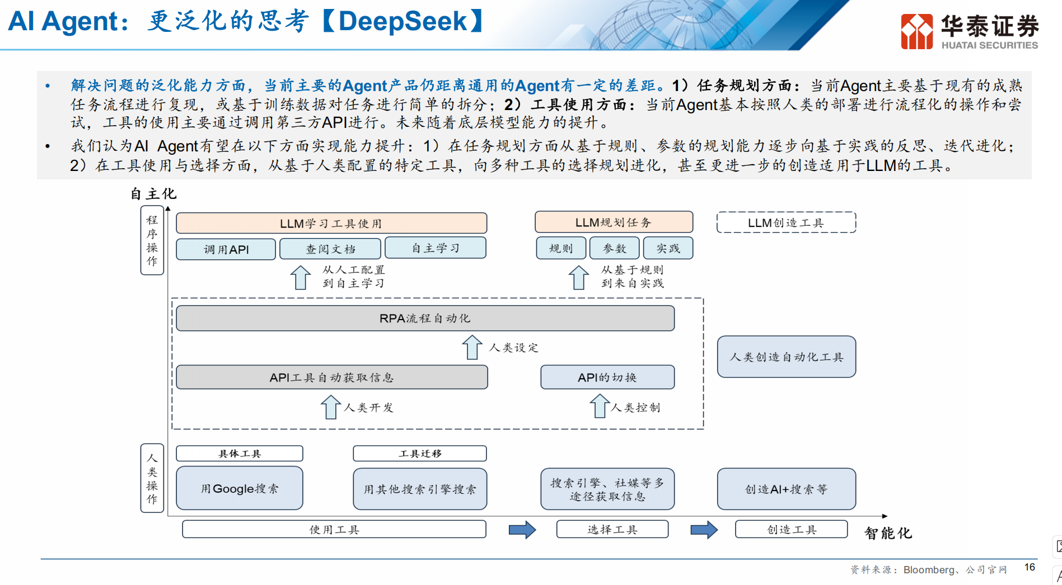
Agentic Workflows: Why, When, How

Slide 27
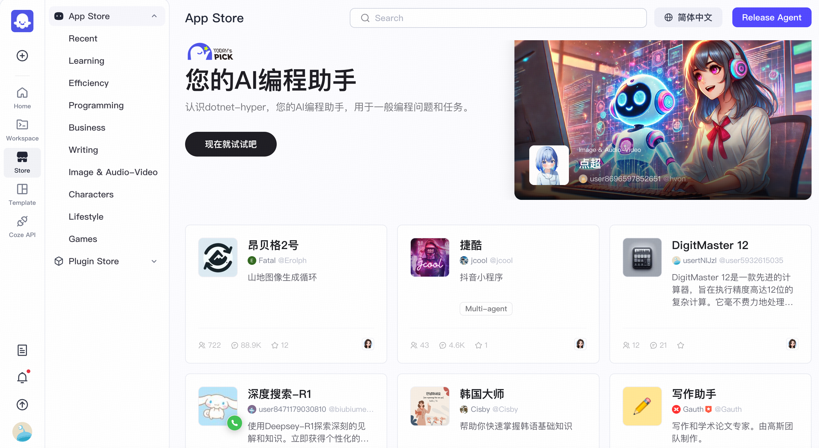
Agentic Workflows: Why, When, How
商业Agentic Workflow平台对比
FastGPT
知识库功能丰富
工作流编排细致
Dify
开源插件生态活跃
Coze
C端用户友好
社区活跃度第一
闭源

Slide 28
机遇与挑战
RAG缺乏可量化指标
Ragas score (Faithfulness, Answer relevancy, Context precision, Context recall)
依赖人工设计benchmark，主观评分
RAG需要长期维护成本
数据清洗，知识库迭代
Agentic workflow开发门槛低，生态百花齐放
不会写代码也可以在coze上一分钟做一个自己的Agent
SGLang对Langchain的加速
Fast Backend Runtime (对标vllm)
Flexible Frontend Language（对标LangChain）
OpenWebUI很多地方是用Langchain做的处理，可能都可以用SGLang重做一遍

Slide 29
推荐阅读
OpenAI DevDay: A Survey of Techniques for Maximizing LLM Performance https://youtu.be/ahnGLM-RC1Y?si=A10cTiYw7rfyRLWX
Swarm https://github.com/openai/swarm
SGLang https://github.com/sgl-project/sglang
Embedding，向量搜索与重排 https://zhuanlan.zhihu.com/p/676996307
MCP Servers https://github.com/modelcontextprotocol/servers

Slide 30
Thanks!
李浩瑞
2025.02.28
北京

